Slide 1
AML Data Labeling Service
Augmenting data with meaningful tags for the purpose of machine learning.

Slide 2
Agenda
Labeling Scenario & Workflow
AML Labeling Service – Vision, Approach, Challenges
Current Priorities
Demo
ML Assist capability

Slide 3
Usage Scenario

Slide 4
Labeling dataflow
Unlabeled
tasks
Unlabeled data
Task creator component
Human labeler
Model output
ML model
Labeled data
Exported labels
Notes:
At high level this is how it works: you have unlabeled data. There is a task creator component that creates tasks for human labelers. Human labelers Pick the task and start labeling so you get label data this thing continues and of course you are free to export the labels if you want . however we do something more interesting once we have a certain number of label data available we train a machine learning model in the background and use the output of the model in various ways initially you can expect that the quality of the model will not be good but still it's usable we can use the output of the model to cluster the data points together. at this point we start giving clustered tasks to labelers and they start seeing very similar images coming together the idea here is to reduce the cognitive load or context switching for them that able to do a better and faster labeling job.

Slide 5
AML Labeling Service - Vision
One-point destination for different labeling needs
Images, Videos, Text, Audio
Comprehensive Project Management
Workflow configuration, Monitoring/Tracking, Quality Assurance
Flexible Workforce
Private workforce, vendors, crowdsourced
ML-Powered Labeling
Pre-labeling, Active Learning, Auto Labeling
Intelligent Labeling Tools
Powered by AI/ML
Seamless Integration with Microsoft Services
Cognitive Services, Azure Machine Learning Services

Slide 6
Approach
 | Accuracy | Efficiency | Cost Effectiveness
ML Powered Labeling | ✓ | ✓ | ✓
Smart Workflows | ✓ | ✓ | ✓
Intelligent Tooling | ✓ | ✓ | ✓
Project Management | ✓ | ✓ | ✓
ML Powered:
Active Learning to prioritize labeling on records that would have highest impact
Assisted labeling to increase human productivity
Auto-labeling if confidence > x
Smart Workflows:
Agile task execution
Multiple labelers per project
Multiple labelers per label
Intelligent task distribution and label merging
Intelligent Tooling:
Specialized labeling tools for different tasks
AI Infused tools
Notes:
Accuracy, Efficiency and Cost effectiveness are at the top of our mind when we are building the Data Labeling service. At high level, we are solving these challenges using a three-pronged approach – ML powered Labeling, Smart Workflows, and Intelligent and Efficient Tools for labeling tasks.
ML Powered Labeling:
As human beings start labeling data, we train a machine learning model, using the data labeled so far, to assist in the labeling process. The model is used to score all the unlabeled data. The model is frequently updated as more and more data is manually labeled. The output of the evaluation is used in the following manner.
Active Learning: We identify the records on which to seek human labels first. These are the records that are likely to give the highest bang for the buck in the process.
Auto-labeling: If the confidence of the model is very high on a data point, we can optionally automatically label that data point.
Assisted labeling: If the confidence of the model is high, but not high enough for auto-labeling, we label the data and then send for human review. This approach expedites the labeling process in certain domains.
Smart Workflows:
Agile task execution: We allow iterative creation, tweaking, and execution of labeling tasks in a project as opposed to one monolithic labeling task. A project manager can monitor and review the quality as the projects proceed.
Multiple labelers per project: Multiple people can work on the labeling task in parallel.
Multiple labelers per label: We allow sending the same labeling task to multiple people in order to remove bias.
Intelligent task distribution and label merging: When multiple people label the task, expectedly they get slightly different results. We use various approached depending on the domain to merge those labels.
Intelligent Tooling:
Specialized labeling tools for different tasks: Giving dedicated tools for each labeling task improves the quality and efficiency of labeling. We spend a lot of time fine tuning the tools for efficiency.
Quality control and two-way feedback in tool: We can communicate feedback from labeler to project manager and vice versa.
We are working to use AI in the labeling task to reduce errors while labeling.

Slide 7
Challenges & Solutions
ML-assisted labeling
Builds on Azure ML datasets, integrated with Azure ML
Prebuilt tools
browser based
Multi-user
Supports iteration, automatic assignment of tasks, and task review
Controlled access, authenticated using AAD or MSA
Various capabilities
Data
Volume of Data
Data movement
Workflow
Distribution of labeling tasks
Project Management
Security
Privacy
Need to iterate
Tooling
Requires labeling tools
Quality Control
(human bias)
Rate of labeling
Cost concerns
Fundamentals
Challenges
Notes:
So let's look at these challenges and how Azure data labeling helps you solve these challenges.
First is about data. If you have huge amount of data you want to avoid moving the data around and still make it available to people to do labeling.
second you need a multi user labeling tool that will allow multiple people to work in parallel to do data labeling.
Third, the workflow: you need to distribute the task among people so that they can work in parallel on different data points. Also, keep in mind that data labeling can often be iterative.
Depending on the volume of the data and the number of people involved labeling can become a project management problem where you need to optimize on cost, time and quality. Quality control is extremely important because poor quality labels mean poor models.
Finally, you want to do your data labeling without compromising on fundamentals that is privacy and security. Many of you might be working on sensitive projects.
(Soln)
Azure ML data labeling integrates with datasets. It consumes a dataset and after labeling it produces a dataset. You get all the benefits that come with the datasets.
It comes with prebuilt, browser based, multi user labeling tools so you don't have to write or maintain your own tool.
On the workflow front it takes care of task distribution and also allows you to iterate on your labeling project which is a very powerful feature.
It has various capabilities for project management,
and of course it built on Top of Azure privacy and security. the labelers who are going to do the labeling are authenticated using a AAD or MSA.

Slide 8
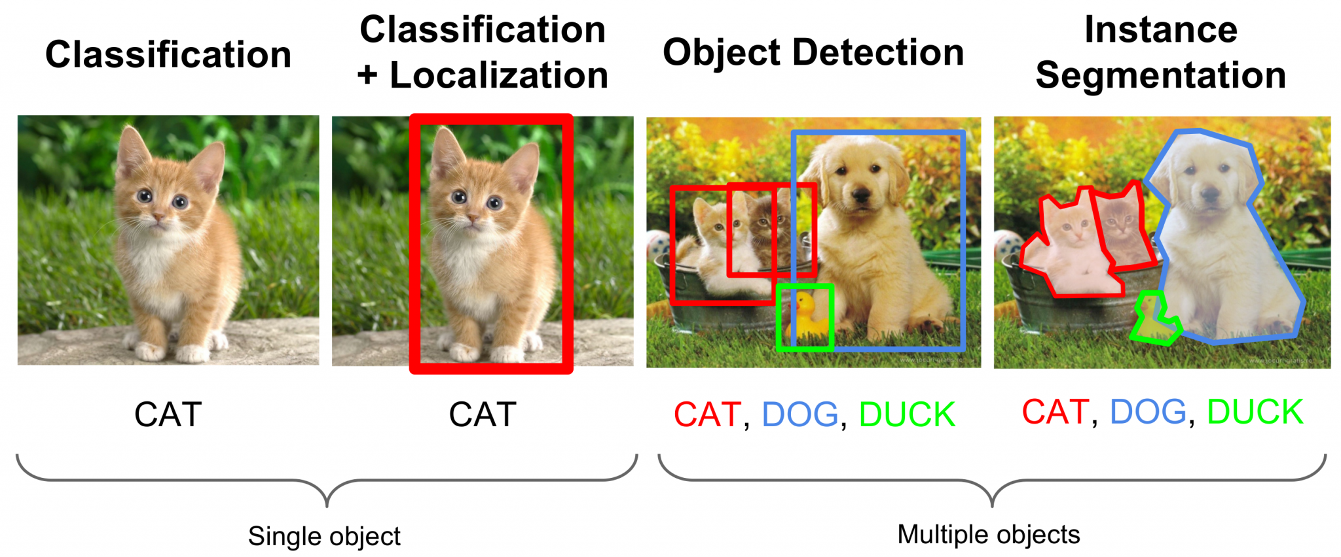
Image labeling: Examples

Slide 9
Target Users
Primary: Labeling Project Manager
Person responsible for getting the data labeled
Typically a member of Data Science team
Secondary: Data Labeler
Person performing the data labeling task
Typically employed by customer either directly or indirectly
May have email address a different domain than customer’s
Notes:
What our personae care about
Project Manager
Highly accurate labels
Labeling velocity
Cost
Data Labeler
Personal Performance
Labeling velocity
Quality of labels

Slide 10
Current priorities
Labeling Tasks
Workforce Support
Images/Videos
Classification
Object Detection
Segmentation
Text
Classification
Named Entity Recognition
Private/Team workforce
Notes:
Images:
Classification: Classifying an image into different categories
Object Detection: Detecting various objects (with corresponding bounding boxes) in an image
Segmentation: Pixel-level accuracy in object detection (drawing polygons around objects)
Text:
Classification: Classifying a piece of text into different categories
Named entity detection: Identifying various entities within text.
Private Workforce:
Customers can use their team of privately recruited resources for labeling purpose. We plan to enable vendor integrations as well as crowdsourcing capabilities in future.

Slide 11

Demo
Azure ML data labeling

Slide 12
Demo flow
Create dataset
Export labels as AML dataset
Use labels to train a model
Create a labeling project
Label data by self
Add labelers
Labeling by other labelers
Check quality of labels
Notes:
Here's our demo flow will first create a data set are based on images that is kept in a blob store then we'll create a labeling project as a data scientist we will label few images ourselves then we will add few more labelers to the project then we'll see how a label can sign in and do the labeling back to the project management portal we will check the quality of labels then will export the labels as a more data set and then use the labels to train a model

Slide 13
ML-assisted data labeling
Accelerate your labeling workflow
Contact us: ml-assisted-labeling@microsoft.com

Slide 14
ML-assisted labeling – Clustering (limited preview)
Unlabeled
tasks
Unlabeled data
Task creator component
Human labeler
Clustered tasks
Model output
ML model
Labeled data
Exported labels
Notes:
At high level this is how it works: you have unlabeled data. There is a task creator component that creates tasks for human labelers. Human labelers Pick the task and start labeling so you get label data this thing continues and of course you are free to export the labels if you want . however we do something more interesting once we have a certain number of label data available we train a machine learning model in the background and use the output of the model in various ways initially you can expect that the quality of the model will not be good but still it's usable we can use the output of the model to cluster the data points together. at this point we start giving clustered tasks to labelers and they start seeing very similar images coming together the idea here is to reduce the cognitive load or context switching for them that able to do a better and faster labeling job.

Slide 15
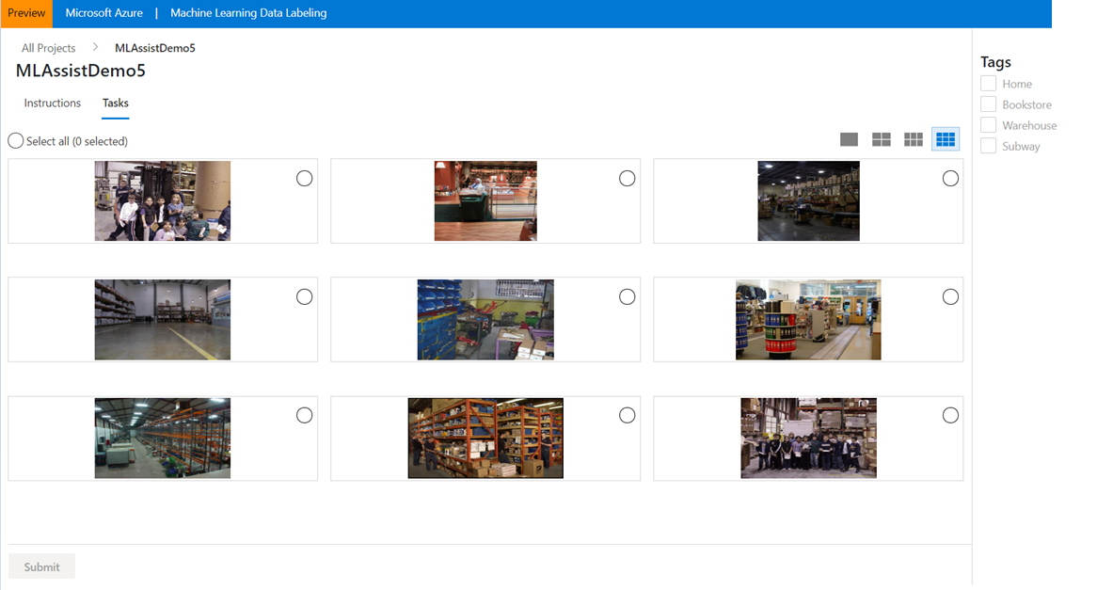
Clustered tasks

Slide 16
ML-assisted labeling – Prelabeling (limited preview)
Unlabeled
tasks
Unlabeled data
Task creator component
Human labeler
Clustered tasks
Pre-labeled tasks
Model output
ML model
Labeled data
Exported labels

Slide 17
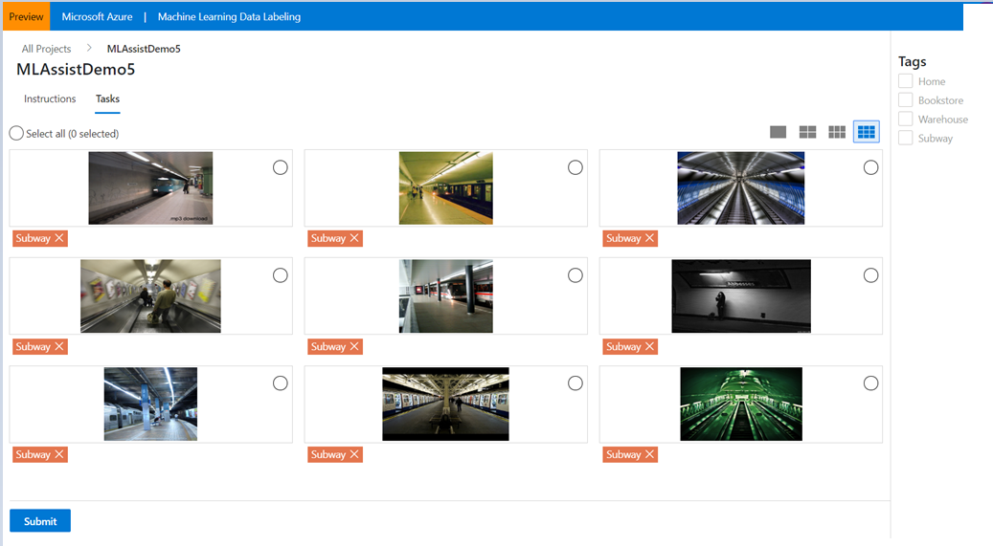
Pre-labeled tasks

Slide 18
Session Resources
Azure ML Studio: https://ml.azure.com
Demo Notebook: https://github.com/Azure/MachineLearningNotebooks/tree/master/how-to-use-azureml/work-with-data/datasets-tutorial
Documentation
Datasets
Creating data labeling project
Labeling data
How to use labeled dataset
Contact for ML assisted labeling: ml-assisted-labeling@microsoft.com

Slide 19
Summary
Data Labeling Service
Goals
Approach
Priorities
Fundamentals
High-accuracy labels
Quick turnaround time
Cost effectiveness
ML-powered labeling
Specialized, efficient labeling tools
Images (Classification, Detection, and Segmentation)
Text (Classification, Entity Detection)
Privacy, Security, Compliance
Data Isolation
Smart workflows for human labelers
Native to Azure ML

Slide 20
Thank you.
vkann@microsoft.com

